Slide 1
eBay and PayPal Test Environment Primer
What is similar, what’s not, challenges, learning and next steps.
Notes:
Introducing project AIR:
Our believe:
By removing the engineering and process road blocks, by adding technology, we can reduce the release workflow from 7+ weeks to under 1 week.
This is to enable you (the PMs) to focus on customer experience instead of worry about the release work flow.

Slide 2
Terminology, Similarities and Differences
eBay | PayPal
Feature pools (e.g. fp001, fp017) | Stage2 machines (e.g. stage2sc5317, stage2vm5019)
“Nuke the pool” | “Restart the services/machine”
Developers test on local boxes | Developers use VMs (Nimbus) and/or Stage1s
Windows & Java stack (little C++) | Linux& C++ stack (little Java)
Partner Contingencies (PCs) | WireOn WireOffs (WoWos)
Prod architecture split between core (US traffic) and intl (ROW) | Prod architecture split based on flow (web, batch, servers, etc.)
Rerolls or Daily Releases | UPRs, AHODs, ISOs
ICE to build and deploy | ICE to build and deploy
Release every 2 weeks, odd numbered releases, e.g. 741, 743 | Release every 2 weeks (BWRs), sequential releases, e.g. 82.0, 83.0

Slide 3
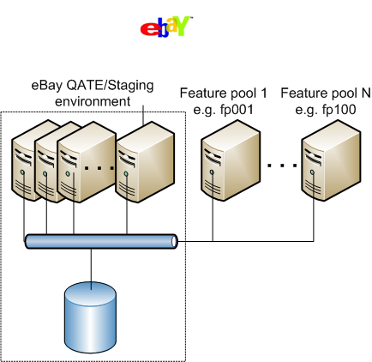
eBay QE environment setup - schematic

Slide 4
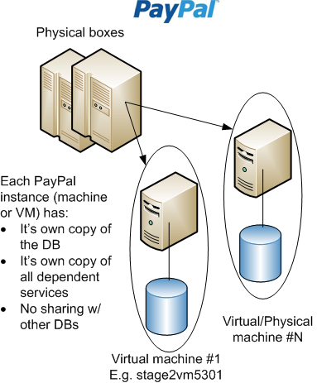
PayPal QA environment setup - schematic

Slide 5
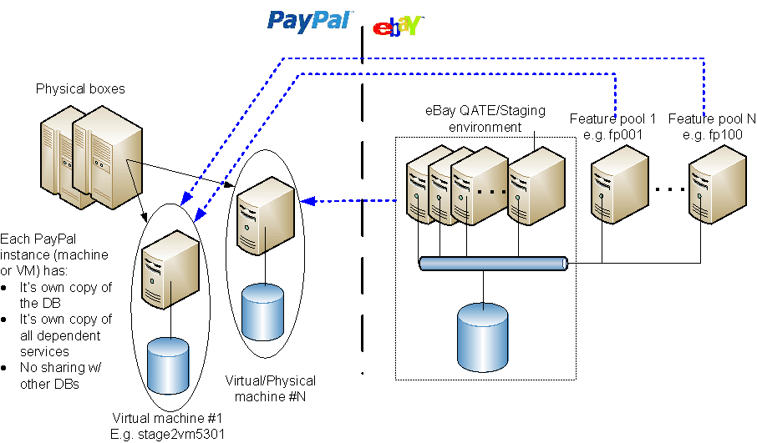
eBay and PayPal environment setup - schematic

Slide 6
Challenges faced in test and setup
PayPal stages are “too slow”.
Sometimes, a single “Pay” calls takes greater than 60 seconds. (or even 3+ minutes sometimes)
Machines are thrashing (paging) and swapping.
High load, in the hundreds
Stage2sc5558:
top - 23:24:48 up 58 days, 8:42, 1 user, load average: 4.13, 5.57, 4.60
Tasks: 1423 total, 1 running, 1418 sleeping, 0 stopped, 4 zombie
Cpu(s): 3.6%us, 1.4%sy, 0.0%ni, 80.6%id, 14.3%wa, 0.0%hi, 0.1%si, 0.0%st
Mem: 16438716k total, 16225416k used, 213300k free, 94268k buffers
Swap: 16582856k total, 8480256k used, 8102600k free, 1314996k cached
Until very recently, lack of dedicated stages.
Slowness persists
Engineers “cycle” through a list of previously known PayPal stages to find one that works...and continue testing

Slide 7
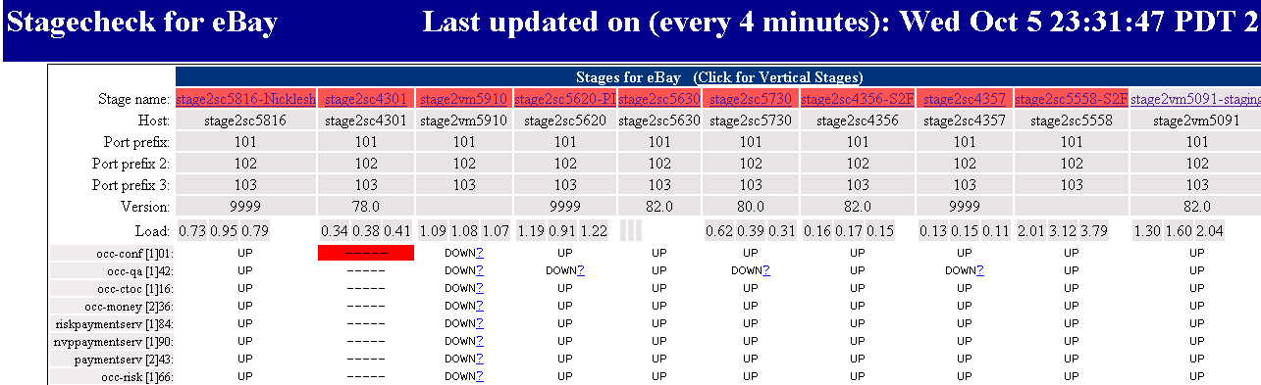
Challenges faced in test and setup - continued
Periodic refresh of DB => loss of accumulated data
Persistent accounts need to be created in the MasterDB, MassPay setup
Lack of a stable and long-lived stage forces many eBay tests to be run on PayPal Sandbox machines.
Repeated setup for Incentives, Shipping Labels, etc. for each stage.
Lack of insight into PayPal service uptimes leads to churn and wasted time
“Doesn’t work, can somebody check?”

Slide 8
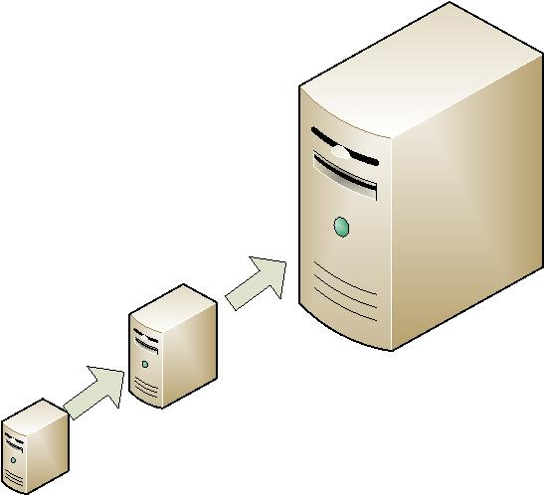
Forward looking
Dedicated box “stage2ebay.qa.paypal.com” being setup.
512G of memory, DL585 16 processor quad-core machine
Dedicated DB instance “stage2ebaydb” being setup
Never recloned. Setup once, preserved forever.
DMLs will be applied just like PayPal Prod and Sandbox
Supported by Ops and DBAs. Will always have current PayPal Prod “Gold” build.
Next steps is to put this machine behind a load balancer and multiple machines for redundancy.
E.g. vip name = stage2ebay.qa.ebay.com and multiple machines stage2ebay1, stage2ebay2, etc. that live behind the vip.
Hoping to solve all regression requirements for eBay.
Next steps: Similar solve for feature testing needs, at a lower scale.

Slide 9
Learning
Engage early, Merge early, Integrate early
Plan for enough machines
We learnt a lot from S2F and implemented it very well for PI
Co-ordination and communication when refreshing builds
Been doing that very well recently
Should lessen or go away completely when the new stage is ready
More to learn about each others environments and typical errors
It never hurts to do a first level of debugging before seeking help
Future Project(s): Will need your support!
Q1 2012, Turbo Checkout aka Inline Checkout aka “One-click” Checkout
Q4 2011, PI follow-ons

Slide 10
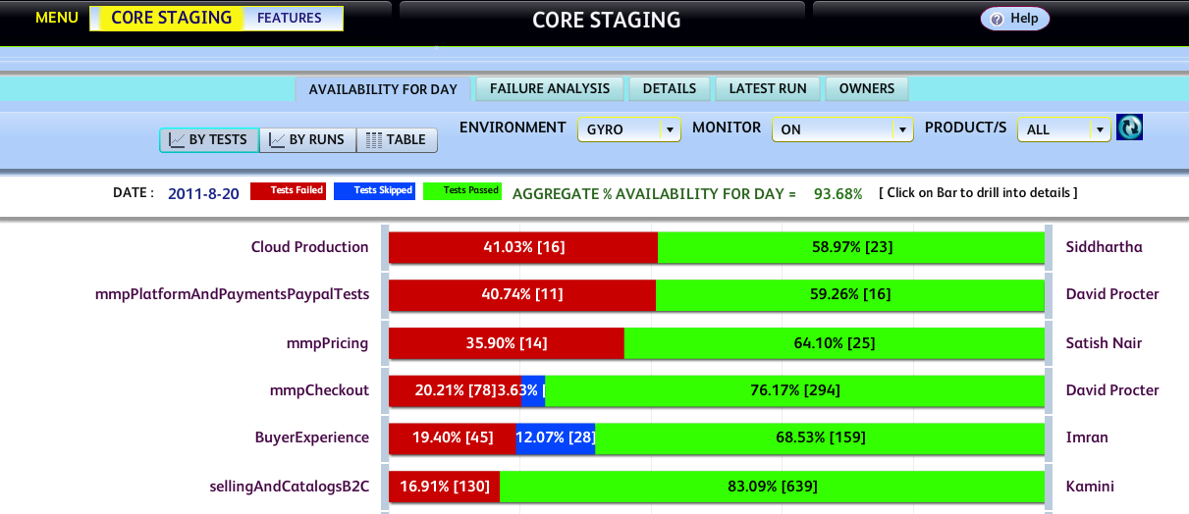
Gyro – eBay’s Regression Environment (QATE) Monitor
How stable is my environment?”
What are the domains failing the most and need the most attention?
File bugs w/ ETAs for each of them. Daily report to Directors.

Slide 11
Questions?

